Slide 1
Improve your Skills as a DBA for Microsoft SQL Server
Uwe Ricken
To define!

Slide 2




Uwe Ricken db Berater GmbH
I am working with IT-systems since early 1990's and with the main focus on Microsoft SQL Server since version 6.0. I started with development of database applications in 1998 with a professional CRM-System based on Microsoft products (Microsoft Office and Microsoft SQL Server).
Since 2008 I'm focused exclusively on Microsoft SQL Server and I was working in 3rd level support teams for enterprise companies, banks and insurances.
Since May 2013 I'm a Microsoft Certified Master: SQL Server 2008 which was an amazing way into the depth of Microsoft SQL Server.
In July 2013 I have been awarded with the MVP Award for Microsoft SQL Server.
www: http://www.db-berater.de
email: uwe.ricken@db-berater.de
blog: http://www.sqlmaster.de
LinkedIn: https://www.linkedin.com/in/uwericken

Slide 3
Break Times
09:00 – 10:30 Session
10:30 – 11:00 Coffee Break
11:00 – 12:30 Session
12:30 – 13:30 Lunch Break
13:30 – 15:00 Session
15:00 – 15:30 Coffee Break
15:30 – 16:45 / 17:00 Session

Slide 4
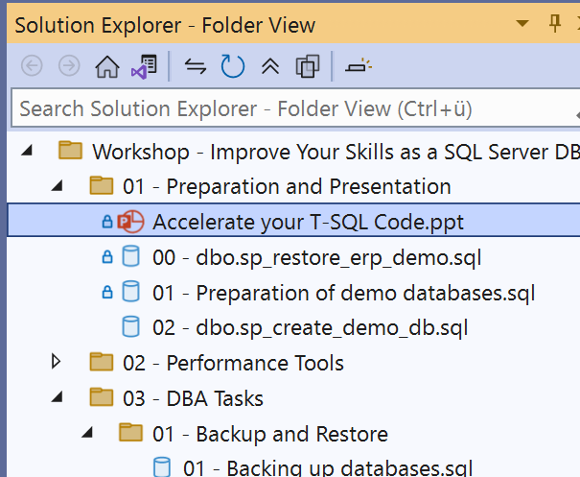
Action List
Download ERP_Demo Database https://www.db-berater.de/downloads/ERP_DEMO_2012.BAK
Download Workshop Solution https://github.com/db-berater/Improve-your-Skills-as-a-SQL-Server-DBA
Open the SSMS Project File in SSMS
Execute the following scripts
00 - dbo.sp_restore_erp_demo.sql
01 - Preparation of demo databases.sql
Check the version of the demo database SELECT * FROM ERP_Demo.dbo.get_database_help_info();;

Slide 5
Improve your Skills as a DBA for SQL Server
Topics to master
Know your Tools you are using daily
Administration of Infrastructure is based on Tools and Knowledge.
Tools do not replace knowledge, but tools support the identification of problems that can be solved with knowledge!
Know your environment
Only those who know the environment can clearly identify a correlation between the problem and its cause.
Know your Team
Know your team and always have contacts in dependent teams to get support quickly (social knowledge).
Storage Team
Virtualization Team
Windows Team

Slide 6
Key Topics
Tools and best practices
using analysis and optimization tools
recommendations for improving query speed.
Backup / Restore
Database Maintenance
Wait Stats Analysis
Locking / Blocking / Deadlocks
Query Problems
High Availability / Replication

Slide 7
Tools and best practices
What Tools does your Team use?
Query Store
Performance Monitor / Resource Monitor
Windows Admin Center
Extended Events
Third Party Tools
Redgate
Idera
Solarwinds
…

Slide 8
Query Store
Source Tool for Query Performance

Slide 9
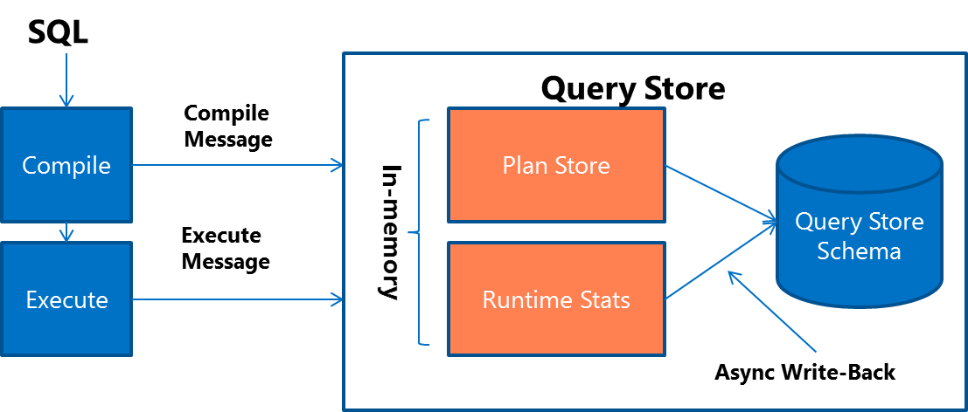
Query Store – Microsoft SQL Server
When a query gets compiled for the first time, query text and the initial plan are sent to Query Store.
When a query gets recompiled, the plan is updated in Query Store.
If a new plan is created, Query Store adds the new plan entry for the query and keeps the previous ones along with their execution statistics.
Upon the query execution, runtime statistics are sent to Query Store.
During the compile and check for recompile phases, SQL Server determines if there's a plan in Query Store that should be applied for the currently running query.

Slide 10
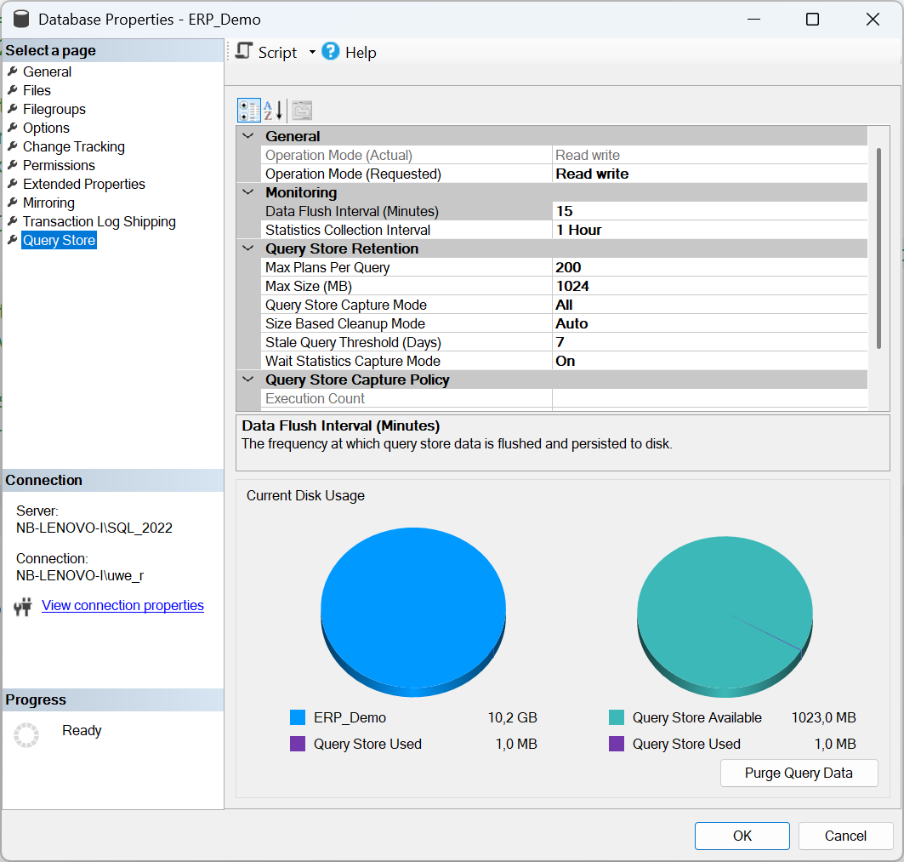
Query Store – Recommended Settings
Data Flush Interval 15 mins
Statistics Collector Interval 1 Hour
Max Size (MB) 1.024 MB
Query Store Capture Mode Auto
Stale Query Threshold 7 Days
Wait Statistics Capture Mode On

Slide 11
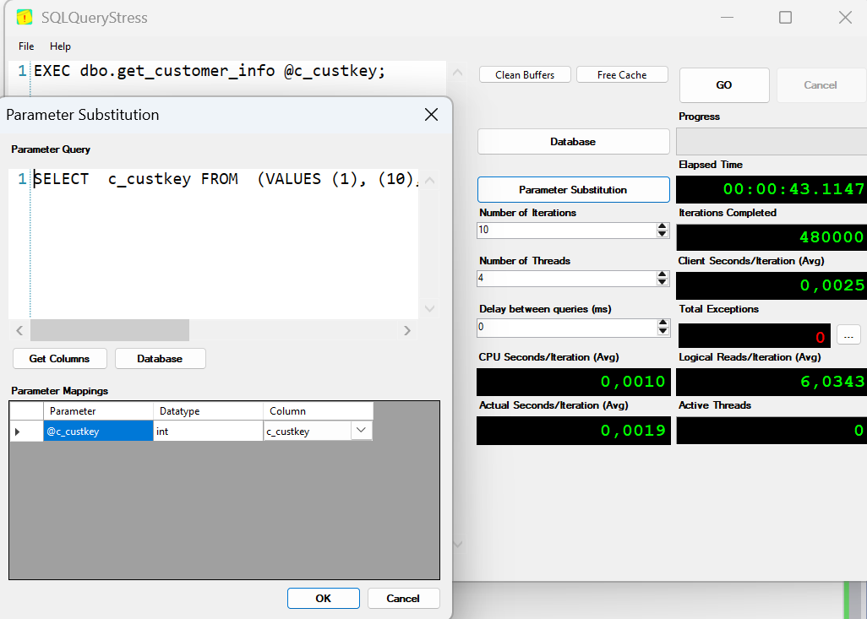
Query Store – Hands On/Demo
open the script 01 – preparation.sql
follow the instructions of the instructor
start SQL Query Stress
Load the pre-configuratino set: 01 – demo of Query Store.json
follow the next instructions of the instructor see the different execution plans in Query Store

Slide 12
Performance Monitor Windows Admin Center
Source Tool for Resource Performance

Slide 13
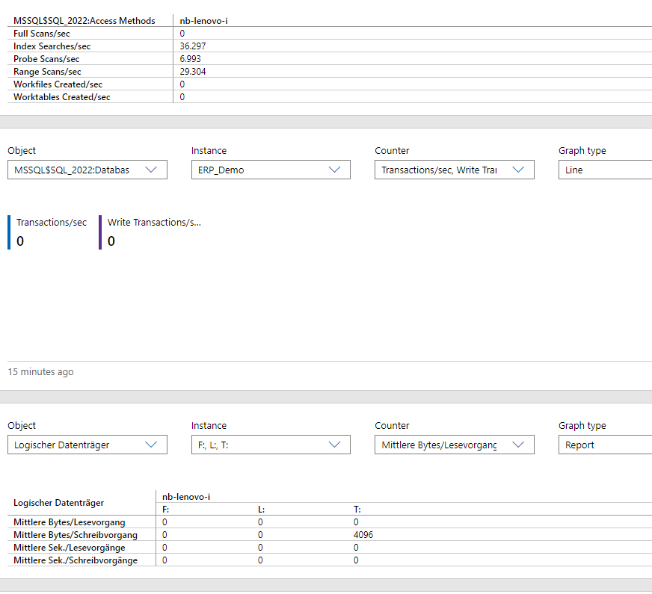
Windows Admin Center vs. PerfMon
Windows Admin Server
Windows Admin Center is generally more suitable for administrators looking for an all-in-one, user-friendly tool for managing multiple servers
ease of use
centralized management.
Performance Monitor
PerfMon remains a powerful tool for more in-depth, counter-specific monitoring on individual servers,
use may be limited to specific scenarios where detailed monitoring is required without needing broader server management features.
Use Windows Admin Center for day-to-day management
Use PerfMon as a specialized tool for deep performance diagnostics

Slide 14
Windows Admin Center – Hands On/Demo
open the script 01 - preparation.sql
follow the instructions of the instructor
start SQL Query Stress
Load the pre-configuration set: Windows Admin Center Demo.json
follow the next instructions of the instructor

Slide 15
Resource Monitor
When things need to happen quickly

Slide 16
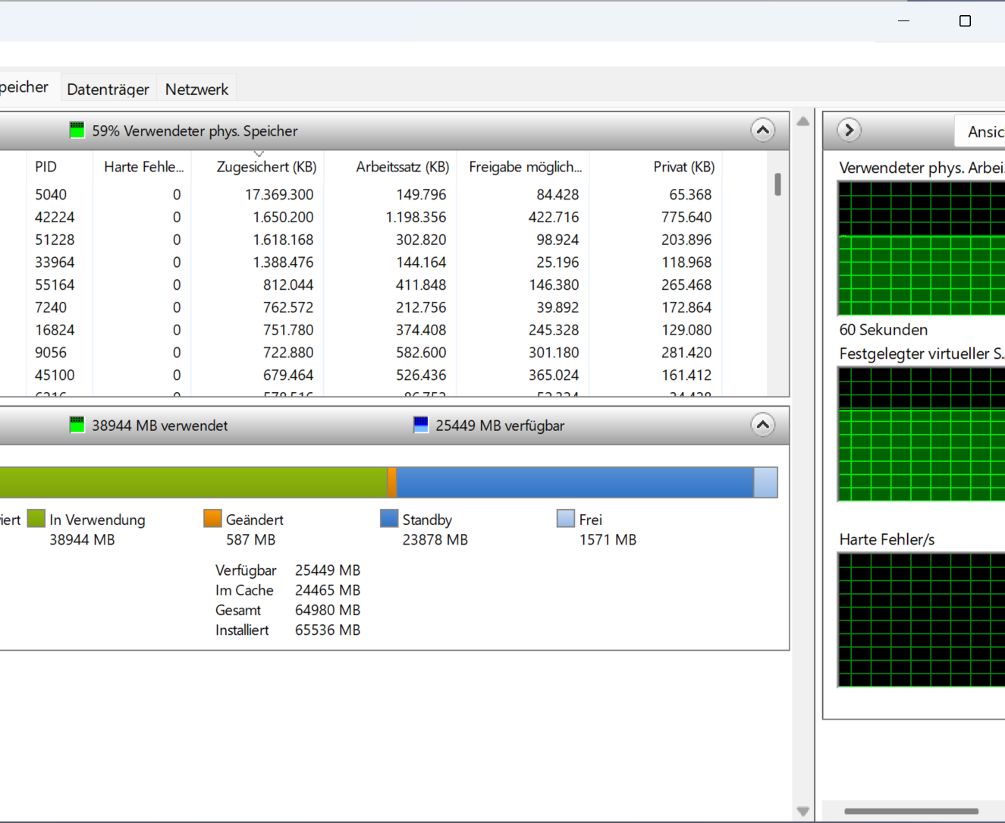
When to use Resource Monitor
Recommended Use Cases
Diagnosing Performance Issues
Monitoring CPU Usage
Tracking Memory Consumption
Investigating Disk Activity
Analyzing Network Traffic
Stopping Problematic Processes

Slide 17
Resource Monitor – Hands On/Demo
Parallel loading of data?

Slide 18
Backup and Restore Strategies
Business Continuity matters

Slide 19
Disaster Recovery
Covers scenarios where data loss is at risk:
Corruption
Hardware Failure
Natural Disaster
Human Error
Notes:
Disaster Recovery is all about what to do when your data is at risk. How do you protect your database from everything from a database administrator (DBA) accidently running a data purge in production instead of quality assurance (QA) to a flood in your primary data center. Questions to ask yourself:
Is your data safe?
How much data is at risk at any given time?
I am taking backups but what happens if they are unavailable?
How will I restore my backups?
Where will I restore the backups?

Slide 20
Restore Strategy
Recovery Point Objective Recovery Time Objective
Restore
Backup
Notes:
Many DBAs think about only how they backup the database. While having a backup plan in place is definitely a good thing, we need to have a more holistic approach. We need to look not only at having backups but how are we going to restore those backups? Also depending on how we do our restores, will this meet the Recovery Point Objective (RPO)/ Recovery Time Objective (RTO) service level agreement (SLAs) we have defined with our customers? A better place to start is by considering what the RPO and RTO goals are and then planning the restore strategy. After it is known how the database will be restored, an effective backup strategy can be created.
A backup and restore strategy is the first step to ensure that the most basic level of disaster recovery is in place. At a minimum, your backup plan includes the following provisions for managing backup media:
A tracking and management plan for storing and recycling backup sets.
A schedule for overwriting backup media.
In a multi-server environment, a decision to use either a centralized or distributed backups.
A means of tracking the useful life of media.
A procedure to minimize the effects of the loss of a backup set or backup media (for example, the loss of a tape).
A decision to store the backup sets either onsite or offsite, and analysis of how this will affect the recovery time.
Designing an effective backup and restore strategy requires careful planning, implementation, and testing. Testing is strongly recommended. You do not need a backup strategy until you have successfully restored backups in all of the combinations that are included in your restore plan.

Slide 21
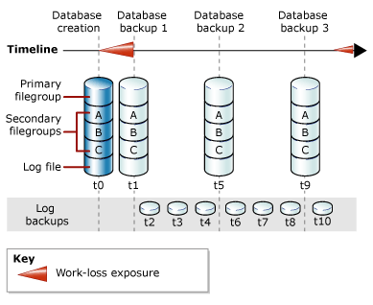
Types of Backups
Database Backups
Full Backup
Differential Backup
Transaction Log Backup
Tail-Log Backup
Partial Backups
File and Filegroup
Notes:
To be able to build an effective Disaster Recovery plan, we first need to understand all the pieces that make up the disaster recovery plan. While planning the strategy, you will want to focus on how you will restore first. However, when learning it is advantageous to start with what types of backups are offered by SQL Server.
SQL Server offers various types of backups to help you meet your disaster recovery goals. This slide is indented to have an overview of various capabilities with SQL Server backups. We will discuss each of these backup options in more detail on the following slides
Types of Backups in SQL Server
Full Database, File, and Filegroup backups: A full database, file, filegroup backup backs up the whole database, file, or filegroup respectively. This includes part of the transaction log so that the full database can be recovered after a full database/file/filegroup backup is restored. Full database/file/filegroup backups represent the database at the time the backup finished. Backing up a specific file or filegroup can increase the speed of recovery by letting you restore only damaged files, without restoring the rest of the database. For example, if a database consists of several files that are located on different disks and one disk fails, only the file on the failed disk has to be restored. Additionally, file/filegroup backups increase flexibility in scheduling and media handling over full database backups, which for very large databases can become unmanageable. However, care must be taken while administering file and filegroup backups because a media failure can make a complete database unrecoverable if a damaged file lacks a backup.
Differential Database, File, and Filegroup backups: A differential backup is based on the most recent, previous full data backup. A differential backup captures only the data that has changed since that full backup. The full backup upon which a differential backup is based is known as the base of the differential.
Transaction Log Backup: With transaction log backups, you can recover the database to a specific point in time (for example, prior to entering unwanted data), or to the point of failure. A log backup taken of the tail of the log just before a restore operation is called a tail-log backup
Partial Backup: A data backup that is based on the latest full backup of a complete or partial database or a set of data files.

Slide 22
Database Recovery Models
Simple
Bulk Logged
Full
Automatic truncation of the log
Certain bulk operations such as BULK INSERT, SELECT INTO, INDEX REBUILD and other are minimally logged
Requires transaction log backups to manage file growth
All operations are fully logged
Point in time recovery permitted
Notes:
The recovery model will affect how SQL Server stores transactions in the transaction log. Thus depending on the recovery model chosen, different backups may or may not be available to you.
Database Administrators should be aware of what recovery model each of their production databases is using, and make sure that is the correct choice to help you meet the business SLAs, Recovery Time Objective (RTO), and Recovery Point Objective (RPO). For example if your RPO is 15 minutes, you must make sure that your backup strategy includes frequent transaction log backups, at least every 15 minutes, and that would require the database to be in the Full or the Bulk Logged Recovery mode. But if your RPO is 24 hours (meaning your business is willing to lose up to 24 hours worth of data), you can choose the Simple recovery model and take daily full backups.
Simple
Automatically reclaims log space to keep space requirements small, essentially eliminating the need to manage the transaction log space. Changes since the most recent backup are unprotected. In the event of a disaster, those changes must be redone. Note that SQL Server still logs transactions in Simple recovery mode. Transaction logging is essential for database durability and consistency.
Full
Requires log backups. No work is lost due to a lost or damaged data file. Can recover to an arbitrary point in time (for example, prior to application or user error). Can recover to a specific point in time, assuming that your backups are complete up to that point in time. This functionality is gained by the fact that no transaction is removed from the transaction log until a transaction log backup is taken. This means care needs to be taken in deciding how often to take transaction log backups because this can directly impact the size of the transaction log.
Bulk Logged
Reduces log space usage by using minimal logging for most bulk operations. Point in time recovery is supported, but only if no bulk logged operations have occurred. Bulk logged operations may be slower on sub-optimal hardware due to the fact that the changes must be flushed to the data file before the transaction commits. This can result in a very high amount of random IO, which can lead to slower performance than the full recovery model.
References:
Recovery Models (SQL Server): http://msdn.microsoft.com/en-us/library/ms189275(v=sql.110).aspx
Choosing the Recovery Model for a Database: http://msdn.microsoft.com/en-us/library/ms175987(v=SQL.105).aspx
Recovery Models for System Databases: http://msdn.microsoft.com/en-us/library/ms365937(v=sql.105).aspx
Operations That Can Be Minimally Logged: http://msdn.microsoft.com/en-us/library/ms191244(v=sql.105).aspx
Considerations for Switching from the Simple Recovery Model: http://msdn.microsoft.com/en-us/library/ms178052(v=sql.105).aspx
Considerations for Switching from the Full or Bulk-Logged Recovery Model: http://msdn.microsoft.com/en-us/library/ms190203(v=sql.105).aspx

Slide 23
Types of Restores
Full Database Restore
Differential Database Restore
Transaction Log Restore
File and Filegroup Restore
Advanced Restore Options:
Page Restore
Automatic Page Repair
Point in time Recovery
Restore to Marked Transaction
Notes:
After understanding of the available backup options and how the database recovery model impacts the types of backups we can have, we can look at the different types of restores. How you design your restore strategy and which restore options you use will directly impact how much data can be recovered (RPO) and how quickly you will be able to restore the database (db) and get it back online (RTO).
Restoring Databases
A restore scenario in SQL Server is the process of restoring data from one or more backups and then recovering the database. The supported restore scenarios depend on the recovery model of the database and the edition of SQL Server. Options exist to recover only up to a point in time or mark within the transaction log file and that these options will also be discussed later in this module.
System databases need to be treated differently. An example is that the instance will not start if the master or model database are not present. Therefore, the restore process involves starting the instance in a special mode to perform the restore. The restore of system databases will be discussed later.
Restore Options
SQL Server 2016 supports the following types of restore operations:
Database Restore using full, differential, and transaction log backups
Restoring a system database such as the Master and MSDB
Partial Database Restore for large databases
File and Filegroup Restore
Advanced restore options such as
Page Level restore
Automatic Page Repair option with AlwaysOn and Database Mirroring
Restore to Marked Transaction
We will be discussing about each of these restore options in detail in the following slides.
References:
Restore and Recovery Overview: http://go.microsoft.com/fwlink/?LinkID=233393
Automatic Page Repair: http://go.microsoft.com/fwlink/?LinkID=237169
Restore to Marked transaction : https://msdn.microsoft.com/en-us/library/ms188623.aspx

Slide 24
Can my plan survive a true disaster?
Offsite backup storage
Multiple datacenters
Access to backups in case of disaster
The only good plan is a tested plan
Notes:
Now that we have looked at the high-level options of what we can do simply within SQL Server, the scope of the possible “disasters” needs to be considered. If a data center is hit by a disaster such as a flood, fire, and so on, how will you recover? Many times we look at drives or servers as single points of failure that need to be protected against, but the entire site could become a single point of failure also.
To protect your backups, the recommendation is at the very least to not keep them on the same drive as your data files to keep the drive from being a single point of failure. Next, we recommend that backups not be stored long term on the same server as your databases as the server could be a single point of failure. For true protection, backups should be stored offsite to ensure that should there be a site-level issue, that your data is still available and safe. Offsite backup storage could be at a second facility within your company, a third-party storage company, Microsoft Azure Blob Storage, and so on.
The important piece of offsite backup storage is how will you get to those backups should a disaster occur. Depending on your RTO, if you have to wait for tape backups to be shipped via ground transportation, it may not be sufficient. Cloud storage services such as Microsoft Azure Blob Storage allow for access to your backups from any site without the need for extra infrastructure. However, with cloud services you will be limited by the bandwidth of retrieving these services. For smaller RTO windows, a second data center with the backups onsite may be required or even a process of creating warm standby servers at the secondary site may even be necessary.
Finally, after devising a disaster recovery plan, the plan should be tested to validate that it does meet the defined SLAs and to find any issues that may not have been apparent when building the plan. DR exercises should be planned and scheduled to happen on a regular basis. Data and architectures change constantly making it imperative that DR exercises are done frequently to validate any changes that do not cause your plan to fail to meet the agreed upon SLAs.

Slide 25
Backup Options
Microsoft Confidential
Notes:
After this lesson, you will be able to:
Identify which types of backups are suitable for different recovery plans
Explain how the choice of backup affects storage and performance.
Why should you learn this material?
Knowing the details of the different backup commands allows you to see the many different trade-offs that exist in using the different backup types. At a high level, the more granular the backup, the higher the administrative and storage cost. This lesson will help you define the costs and the benefits of each type of backup.

Slide 26
Full Backup
Backup of the entire database
Only allocated pages are included in the backup. Free space in database files is not.
Includes data up to the point in time when the reading portion of the backup is completed
Does not allow recovery to a specific point in time
Always includes some transaction log data
Transactionally consistent even though DML statements are allowed during a backup operation
Notes:
Full Database Backup
A full database backup backs up the whole database. This includes part of the transaction log so that the full database can be recovered after a full database backup is restored. Full database backups represent the database at the time the backup finished. As a database increases in size, full database backups take more time to finish and require more storage space. Therefore, for a large database, you might want to supplement a full database backup with a series of differential database backups.
A full database backup provides a complete copy of the database and provides a single point-in-time to which the database can be restored. Even though it may take many hours for the backup process to run, you can still only restore the backup to a single point. A full backup does not allow recovery to any point in time while the backup was running. This is also the same for differential backups. There is a misconception about this, however, fueled by the fact that you can use the WITH STOPAT=<a time or log sequence number> option on a restore of full and differential backups. Although the syntax allows it, the option has no effect and is just there for convenience. For more information, please refer to this article - http://blogs.msdn.com/b/arvindsh/archive/2007/06/15/the-role-of-stopat-in-restore-database.aspx
Another misconception about full backups is that they only back up the data file. Both full backups and differential backups also contain some transaction log records so that the restored component (database, file, or filegroup) can be made transactionally consistent.
A full backup does the following:
Force a database checkpoint and make a note of the log sequence number at this point. This flushes all updated-in-memory pages to disk before anything is read by the backup to help minimize the amount of work the recovery part of restore has to do.
Start reading from the data files in the database.
Stop reading from the data files and make a note of the log sequence number of the start of the oldest active transaction at that. For more information, please refer to http://technet.microsoft.com/en-us/magazine/2009.02.logging.aspx?pr=blog
Read as much transaction log as is necessary.
References:
Full Database Backups (SQL Server): http://technet.microsoft.com/en-us/library/ms186289(v=sql.110).aspx
BACKUP: http://msdn.microsoft.com/en-us/library/ms186865.aspx
Understanding SQL Server Backups: http://technet.microsoft.com/en-us/magazine/2009.07.sqlbackup.aspx
How to: Back Up a Database (SQL Server Management Studio): http://technet.microsoft.com/en-us/library/ms187510(v=sql.105).aspx
How to: Create a Full Database Backup (Transact-SQL): http://technet.microsoft.com/en-us/library/ms191304(v=SQL.105).aspx

Slide 27
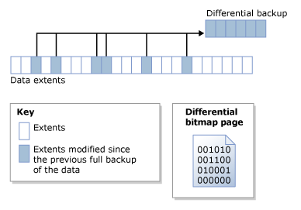
Differential Backups
Backup of the extents changed since the last full database backup
Store active part of the transaction log
Independent of other differential backups
Faster to restore than restoring transaction log backups for the same time period
Notes:
*Differential Database Backup
A differential database backup records only the data that has changed since the last full database backup. This full backup is called the differential base. Modified extents are tracked using a Differential Change Map allocation page. Differential database backups are smaller and faster than full database backups. This saves backup time at the cost of increased complexity. For large databases, differential backups can occur at shorter intervals than database backups. This reduces the work-loss exposure. Differential database backups are especially useful if a subset of a database is modified more frequently than the rest of the database. In these cases, differential database backups enable you back up frequently without the overhead of full database backups.
A common misconception regarding Differential backups is that differential backups are incremental. They are actually cumulative and successive differential backups after a full backup and will increase in size as more data is changed or added.
Differential backups can really speed up restore operations by allowing many transaction log backups to be skipped in the restore process. It is much faster to essentially jump forward in time using a differential backup than to have to replay a lot of transaction log records to get to the same point in time. Due to the nature of differential backups, they generally become larger over time as a larger percentage of the database has changed since the last full backup. As the differential backup becomes larger, the benefit of using a differential backup versus a full backup becomes less. It is important to evaluate the size and performance of your differential backups to determine how often full backups are necessary.
One important point to note is that neither the full database backup, nor the differential backup has any influence on the transaction log truncation. Only transaction log backups, truncate the transaction log.
References:
Differential Backups (SQL Server): http://go.microsoft.com/fwlink/?LinkID=233386
Differential Database Backups: http://go.microsoft.com/fwlink/?LinkID=237167
Understanding SQL Server Backups: http://technet.microsoft.com/en-us/magazine/2009.07.sqlbackup.aspx
How to: Create a Differential Database Backup (SQL Server Management Studio): http://technet.microsoft.com/en-US/library/ms188248(v=SQL.90).aspx

Slide 28
Transaction Log Backups
Includes log records since the last log backup
These are incremental backups
Inactive log records are attempted to be truncated afterwards
This may not always occur
Database must be in full or bulk-logged recovery model
Required for point-in-time recovery
Notes:
Log backups are necessary for a point-in-time restore as they allow you to specify what time in the transaction log to stop. Transaction log backups are only available using the Full and Bulk-Logged recovery models.
A transaction log backup has all the log records generated since the last transaction log backup (or full backup that starts a log backup chain) and is used to allow the database to be recovered to a specific point in time. This means they are incremental, unlike differential backups, which are cumulative. Since these are incremental, if you want to restore the database to a particular point in time, you need to have all the transaction log records necessary to replay database changes up to that point in time. These are contained in the log backup chain.
It is vital to the restore process that an unbroken chain of transaction log backups exist. If the sequential transaction log backups do not exist, then a point in time restore may not be possible. The following actions will break the log chain, and potentially introduce data loss into the recovery scenario:
Changing from the Full or Bulk logged recovery model to the simple recovery model
Reverting from a database snapshot
Deleting a log backup
Forcibly clearing the log using the WITH NO_LOG or TRUNCATE_ONLY options (which are not available in SQL Server 2008)
Log backups are also required to help manage the size of the transaction log. In the FULL or BULK_LOGGED recovery models, the log will not clear until a log backup has been performed, so regular log backups must be performed to prevent the log file from growing out of control. If the log cannot clear, the log will grow until it runs out of space. As such, if you do not want to do point-in-time recovery using log backups, the easiest option is to switch to the SIMPLE recovery model and not use the FULL or BULK_LOGGED recovery models.
Extents changed in a minimally logged operation in the bulk logged recovery model will always be included in the transaction log backup. The extents changed by a bulk logged operation are listed in the Bulk Change Map (BCM) page. The BCM is a bit map of all extents modified by a bulk logged operation. The inclusion of extents changed in bulk logged operations may cause the transaction log backup to be larger than normal depending on the amount of data changed in the bulk operation.
References:
Transaction Log Backups (SQL Server): http://technet.microsoft.com/en-us/library/ms191429.aspx
Working with Transaction Log Backups: http://msdn.microsoft.com/en-US/library/ms190440(v=sql.105).aspx
Understanding SQL Server Backups: http://technet.microsoft.com/en-us/magazine/2009.07.sqlbackup.aspx
How to: Back Up a Transaction Log (SQL Server Management Studio): http://msdn.microsoft.com/en-US/library/ms179478(v=SQL.105).aspx
How to: Create a Transaction Log Backup (Transact-SQL): http://msdn.microsoft.com/en-US/library/ms191284(v=sql.105).aspx

Slide 29
File/Filegroup Backups
Provides functionality to backup a single file or a single filegroup
Useful for large databases
Allows for flexible backup and restore
Limited use in Simple Recovery Model
Notes:
Files or filegroups in a database can be backed up and restored individually. This allows you to restore only the damaged files without having to restore the rest of the database. Files in a filegroup backup can be restored individually or as a group
You must use file and filegroup backup and restore operations in conjunction with transaction log backups. After you restore the files, you must restore the transaction log backups that were created since the file backups were created to bring the database to a consistent state. It is not necessary to apply a transaction log backup if SQL Server can determine that the files or filegroups have not been modified after the file or filegroup backup was created
In a file restore, the goal is to restore one or more damaged files without restoring the whole database. Under the simple recovery model, file backups are supported only for read-only files. The primary filegroup and read/write secondary filegroups are always restored together, by restoring a database or partial backup.
It is not possible to stop the recovery of individual files early. For this reason, you must always back up the active transaction log prior to restoring a file backup. If the transaction log is damaged or if you wish to recover the entire database to a specific point in time, you must restore the entire set of file backups before you apply transaction log backups.
There are two file-restore scenarios as follows:
Offline file restore: In an offline file restore, the database is offline while damaged files or filegroups are restored. At the end of the restore sequence, the database comes online. All editions of SQL Server 2012 support offline file restore.
Online file restore: In an online file restore, if database is online at restore time, it remains online during the file restore. However, each filegroup in which a file is being restored is offline during the restore operation. After all the files in an offline
filegroup are recovered, the filegroup is automatically brought online.
Limitations and Restrictions
The system administrator restoring the files and filegroups must be the only person currently using the database to be restored.
RESTORE is not allowed in an explicit or implicit transaction.
Under the simple recovery model, the file must belong to a read-only filegroup.
Under the full or bulk-logged recovery model, before you can restore files, you must back up the active transaction log (known as the tail of the log). For more information, see Back Up a Transaction Log (SQL Server).
To restore a database that is encrypted, you must have access to the certificate or asymmetric key that was used to encrypt the database. Without the certificate or asymmetric key, the database cannot be restored. As a result, the certificate that is used to encrypt the database encryption key must be retained as long as the backup is needed. For more information, see SQL Server Certificates and Asymmetric Keys.
References:
Description of restoring file and filegroup backups in SQL Server: http://support.microsoft.com/kb/281122
Restore Files and Filegroups (SQL Server): http://technet.microsoft.com/en-us/library/aa337540.aspx
Restore Files and Filegroups over Existing Files (SQL Server): http://technet.microsoft.com/en-us/library/ms187090.aspx
Restore Files to a New Location (SQL Server): http://technet.microsoft.com/en-us/library/ms190255.aspx
File Restores (Simple Recovery Model): http://technet.microsoft.com/en-us/library/ms190388.aspx
File Restores (Full Recovery Model): http://technet.microsoft.com/en-us/library/ms190710.aspx
US/library/ms191284(v=sql.105).aspx

Slide 30

Backup Databases

Slide 31
Restore and SLA
Restore is dependent on how the database was backed up
Given the backups, can the database be restored to meet RTO and RPO objectives?
Simple Strategies:
Use full backups and transaction log backups
Generally, can meet RPO objectives
As databases increase in size, RTO can be difficult to achieve
Complex Strategies
Use of Differential, File- or Filegroup backups
Piecemeal Restore
Notes:
Meeting RTO and RPO goals means you must have a well thought out and tested restore strategy. Generally backup strategies are created with protecting data in mind which is good for RPO goals. However, the time it takes to restore the backups is sometimes just as important if not more important than recovering all the current data. For example, many companies will create a default backup plan that does nightly backups and hourly transaction log backups. If this strategy is employed on a data warehouse that is 2 TB, you will be able to restore the data. However, the time to restore a single full backup may take hours if not an entire day depending on the network latencies and drive speeds.
Meeting SLAs generally means having a good restore strategy, which then leads to the proper backup strategy. Reviewing and testing your restore plan periodically is key to knowing that your plan works and that as databases change over time that the strategy in place is still the proper plan.
Simple strategies are often good for ease of management and ease of restore if needed. Doing a routine full backup and frequent transaction log backups can protect most databases up to the desired RPO. Also due to the basic nature of the strategy there is little risk in a DR situation that a DBA (even one not familiar with the application or infrastructure) could likely do the restore.
Using complex strategies that make use of the full range of backups and restores have the ability to better protect the data and minimize the time to bring a database online. Utilizing filegroup backups allows for a piecemeal restore where the important pieces of the database can be restored first and brought online without waiting for the entire database to be restored. However, having complex strategies require accurate documentation to ensure that in a DR situation any person may be able to pickup the documentation and do the restores. Generally, the process and flow will be too complicated to be able to quickly determine how to do the restore without documentation.

Slide 32
Full and Differential Restores
Both Full and Differential use the RESTORE DATABASE command
Use WITH DIFFERENTIAL for differential restores
Full backups must be restored first
Only the LAST differential database backup needs to be restored
Use WITH REPLACE to overwrite an existing database
Use WITH NORECOVERY to leave the database in a restoring state to apply addition backups
The last restore command should use WITH RECOVERY to bring the database online
Notes:
If no differential or log backups are required, all that is required is a full database restore WITH RECOVERY (which is the default).
If any differential backups have occurred:
Full database backup must be restored first. It serves as the base for any differential backup. The WITH NORECOVERY option must be specified to allow a differential or log backup to be applied to the previous full database restore.
2. Restore the differential backup. The differential backup consists of the extents changed since the last full backup. During the restore process these extents will be written to the file. The transaction log entries stored during the backup the database will be recovered if WITH RECOVERY is used.
Additional transaction log backups can be applied using the WITH NORECOVERY option.
Reference:
Complete Database Restores (Simple Recovery Model): http://technet.microsoft.com/en-us/library/ms186216.aspx
Complete Database Restores (Full Recovery Model): http://technet.microsoft.com/en-us/library/ms187495.aspx
How to: Restore a Differential Database Backup (SQL Server Management Studio): http://go.microsoft.com/fwlink/?LinkID=233394
How to: Restore a Differential Database Backup (Transact SQL): http://go.microsoft.com/fwlink/?LinkID=233545
Phases of a restore including the data copy phase, the redo phase and the undo phase.
The data copy phase involves file creation and copying all data and log pages from the backup media.
The redo phase applies the transactions to the data copied from the backup to be rolled forward to the recovery point.
The undo phase rolls back any uncommitted transactions.
After the undo phase, subsequent backups cannot be restored. This is why it is critical to always perform restores initially using WITH NORECOVERY. You can later recovery the database in a separate step.
SQL Server 2005 Enterprise Edition and later versions let users access the database during the undo phase. This is known as fast recovery.
Why does SQL Server need to redo and undo transactions when only restoring a full database backup?
The full database backup is a online operation, which means that transactions can occur during the backup. Therefore, the data and index pages stored on the backup device can be from different points in time and versions. To restore the database to a consistent state, SQL Server needs to apply the transaction log entries saved during the full database backup to recover the database to a transactional consistent state. This means that all transactions that are committed before the recovery point are present and all uncommitted transactions are undone. The recovery point for full database backups is the end of the backup.
References:
Understanding How Restore and Recovery of Backups Work in SQL Server: http://go.microsoft.com/fwlink/?LinkID=213409

Slide 33
File, Filegroup, Piecemeal Restores
Large database can be restored in pieces
Primary filegroup must always be restored
Transaction log restores needed to bring all filegroups to the same point in time.
Online filegroup restores are enterprise edition only
Notes:
Files or filegroups in a database can be backed up and restored individually. This allows you to restore only the damaged files without having to restore the rest of the database. Files in a filegroup backup can be restored individually or as a group
You must use file and filegroup backup and restore operations in conjunction with transaction log backups. After you restore the files, you must restore the transaction log backups that were created since the file backups were created to bring the database to a consistent state. It is not necessary to apply a transaction log backup if SQL Server can determine that the files or filegroups have not been modified after the file or filegroup backup was created
In a file restore, the goal is to restore one or more damaged files without restoring the whole database. Under the simple recovery model, file backups are supported only for read-only files. The primary filegroup and read/write secondary filegroups are always restored together by restoring a database or partial backup.
It is not possible to stop the recovery of individual files early. For this reason, you must always back up the active transaction log prior to restoring a file backup. If the transaction log is damaged or if you wish to recover the entire database to a specific point in time, you must restore the entire set of file backups before you apply transaction log backups.
There are two file-restore scenarios as follows:
Offline file restore: In an offline file restore, the database is offline while damaged files or filegroups are restored. At the end of the restore sequence, the database comes online. All editions of SQL Server 2016 support offline file restore.
Online file restore: In an online file restore, if database is online at restore time, it remains online during the file restore. However, each filegroup in which a file is being restored is offline during the restore operation. After all the files in an offline filegroup are recovered, the filegroup is automatically brought online.
Limitations and Restrictions
The system administrator restoring the files and filegroups must be the only person currently using the database to be restored.
RESTORE is not allowed in an explicit or implicit transaction.
Under the simple recovery model, the file must belong to a read-only filegroup.
Under the full or bulk-logged recovery model, before you can restore files, you must back up the active transaction log (known as the tail of the log). For more information, see Back Up a Transaction Log (SQL Server).
To restore a database that is encrypted, you must have access to the certificate or asymmetric key that was used to encrypt the database. Without the certificate or asymmetric key, the database cannot be restored. As a result, the certificate that is used to encrypt the database encryption key must be retained as long as the backup is needed. For more information, see SQL Server Certificates and Asymmetric Keys.
References:
Description of restoring file and filegroup backups in SQL Server: http://support.microsoft.com/kb/281122
Restore Files and Filegroups (SQL Server): http://technet.microsoft.com/en-us/library/aa337540.aspx
Restore Files and Filegroups over Existing Files (SQL Server): http://technet.microsoft.com/en-us/library/ms187090.aspx
Restore Files to a New Location (SQL Server): http://technet.microsoft.com/en-us/library/ms190255.aspx
File Restores (Simple Recovery Model): http://technet.microsoft.com/en-us/library/ms190388.aspx
File Restores (Full Recovery Model): http://technet.microsoft.com/en-us/library/ms190710.aspx

Slide 34
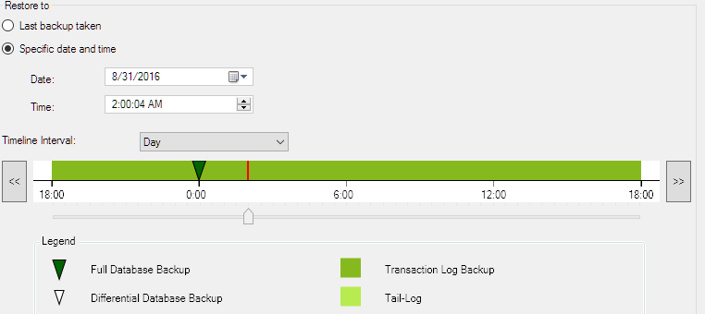
Database Recovery Advisor
Microsoft SQL Sever Management Studio Database Recovery Advisor facilitates the construction of restore plans that implement optimal correct restore sequences
Restore-plan algorithm: Improved for complex restore scenarios
Point-in-time restores: Simplified restoration of database to given point in time, and automatically includes backups relevant to desired restore point
Notes:
Restore-plan algorithm: The algorithm used to construct restore plans has improved significantly, particularly for complex restore scenarios. Many edge cases, including forking scenarios in point-in-time restores, are handled more efficiently than in previous versions of SQL Server.
Point-in-time restores: The Database Recovery Advisor greatly simplifies restoring a database to a given point in time. A visual backup timeline significantly enhances support for point-in-time restores. This visual timeline allows you to identify a feasible point in time as the target recovery point for restoring a database. The timeline facilitates traversing a forked recovery path (a path that spans recovery forks). A given point-in-time restore plan automatically includes the backups that are relevant to the restoring to your target point in time (date and time).
For more information:
Restore a SQL Server Database to a Point in Time (Full Recovery Model)
https://msdn.microsoft.com/en-us/library/ms179451.aspx?f=255&MSPPError=-2147217396

Slide 35
Backup Databases

Slide 36
Backup Location
Local Storage:
Limited by disk IO performance
Should always be a different drive from the database files
Network Storage:
Safer than local
Limited by network throughput
Microsoft Azure Storage:
Offsite backups with DR built in for files stored in Microsoft Azure
Accessible from anywhere
Tape Storage:
Lowest cost
Slowest performance
Notes:
The first choice generally made after deciding what backups you will need to take to meet SLAs is to chose where to store your backups.
Local disk storage (locally attached disk or SAN attached disk) will generally be the fastest storage for backups as the bottleneck is disk IO performance. This performance does come with a couple considerations:
--Storage costs: Local disks/SAN disk is generally more expensive storage.
--Management: Most backup retention policies require at least a week’s worth of backups. Depending on the size of the databases even a week’s worth of backups could be a considerable amount of storage.
--Durability: If the backups are stored on the same machine as the databases, the recovery plan is vulnerable to server outages. At the very least, backups should never be stored on the same drive as the database files. This prevents a single disk from potentially causing data loss and backing up to the same disks as the database files could cause the disk to become an IO bottleneck.
I
Network Storage:
Backing up to a dedicated file server on a different server can help reduce many of the costs associated with local storage. Having a network location also allows for a centralized store for multiple SQL Server instances, which can help to reduce backup management complexity. Additionally, with backups stored on a remote server, the SQL Server itself is no longer a single point of failure. The biggest limiting factor for network backups is the network IO performance. Sending large databases of 100s of GB across the network can take a substantial amount of time.
Microsoft Azure storage is new to SQL Server 2014. Backups can be written to Azure Blob Services. The benefits of Azure backups are that backups are kept remotely, yet can be accessed from any location with an internet connection. Also, Windows Blob Service has a minimum of local redundancy but can be set up with geographically disperse copies of your data also for better protection.

Slide 37
Backup Options
Striping backup across several backup files will also increase throughput
A dedicated IO path (network card or host bus adapter (HBA)) can improve throughput.
Adjust the BUFFERCOUNT and MAXTRANSFERSIZE
BUFFERCOUNT: Specifies the total number of IO buffers to use.
MAXTRANSFERSIZE: Specifies the largest unit of bytes to transfer between SQL Server and the backup media
The total space used by buffers is (BUFFERCOUNT * MAXTRANSFERSIZE)
Notes:
Optimizing Backup Performance
Performance of backup operations may be increased by utilizing multiple backup devices and/or increasing BUFFERCOUNT. Using multiple devices over a single device with increased BUFFERCOUNT may offer a slight additional benefit. However, use of a single device with increased BUFFERCOUNT may provide nearly the same throughput without the need to manage multiple backup files. MAXTRANSFERSIZE should be considered a secondary tuning approach. In our tests, this provided little practical benefit over the default used by BACKUP.
Be careful while increasing the value of the BUFFERCOUNT parameter on 32-bit systems because specifying too high values for this may result in out-of-memory errors because there is a limited amount of virtual address space available for this. On 32-bit systems, the default amount of virtual address space outside of the buffer pool is 256 MB.
Note: Watch the SQL Server error log for a high number of Virtual Log Files (VLFs) which can affect restore performance and technologies that use the transaction log such as replication: http://support.microsoft.com/kb/2455009
References:
Optimizing Backup and Restore Performance in SQL Server: http://technet.microsoft.com/en-us/library/ms190954(SQL.105).aspx
Over 2 GBps SQL Server 2012 backup on 12-core server with 7 Fusion-IO Cards!: http://blogs.msdn.com/b/microsoftbob/archive/2012/10/18/2gbps-backup-on-12-core-server-with-7-fusion-io-cards.aspx
http://blogs.msdn.com/b/sqlserverfaq/archive/2010/05/06/incorrect-buffercount-data-transfer-option-can-lead-to-oom-condition.aspx and http://support.microsoft.com/kb/904804?wa=wsignin1.0

Slide 38
Corrupt Databases
A database dies a slow death

Slide 39
What is Database Corrpution?
Database corruption occurs when data structures within the database become unreadable or inconsistent
Common Causes:
Disk I/O errors or bad sectors
Power outages or forced shutdowns
Memory corruption or faulty drivers
SQL Server bugs or misconfigured settings
Symptoms:
Errors like Msg 824, Msg 825, or Msg 823
Inaccessible tables or indexes
Failed backups or restores
Impact:
Can lead to data loss, downtime, and compromised integrity if not detected early.

Slide 40
How to Detect and Fix Corruption
Detection Tools
DBCC CHECKDB()
SQL Server Error Logs and Windows Event Viewer
- Recovery Options
Restore from Backup
Safest method if clean backups exist
Repair Options
If an index is damaged (not Clustered Index!) just rebuild it
REPAIR_REBUILD
REPAIR_ALLOW_DATA_LOSS
Prevention Tips:
Use ECC memory and reliable storage
Enable regular DBCC CHECKDB jobs
Maintain offsite and verified backups
Monitor for early signs using alerts and health checks

Slide 41
Repair a corrupt database

Slide 42
Locking / Blocking
controlling the management of concurrency

Slide 43
Lock Types
Lock Intension | Lock Type | Description
Exclusive Lock | X | This lock type, when imposed, will ensure that a page or row will be reserved exclusively for the transaction that imposed the exclusive lock, as long as the transaction holds the lock.
Shared Lock | S | This lock type, when imposed, will reserve a page or row to be available only for reading, which means that any other transaction will be prevented to modify the locked record as long as the lock is active.
Update Lock | U | this lock is similar to an exclusive lock but is designed to be more flexible in a way. An update lock can be imposed on a record that already has a shared lock. In such a case, the update lock will impose another shared lock on the target row.
Intent Lock | I (X/S/U) | this lock is a means used by a transaction to inform another transaction about its intention to acquire a lock.
Convertion Locks
Shared w Intent exclusive | SI(X/U) | when acquired, this lock indicates that the transaction intends to read all resources at a lower hierarchy and thus acquire the shared lock on all resources that are lower in hierarchy, and in turn, to modify part of those, but not all

Slide 44
Lock Status
 | Hold Lock
Request | IS | S | U | IX | SIX | X
IS | ✓ | ✓ | ✓ | ✓ | ✓ | X
S | ✓ | ✓ | ✓ | X | X | X
U | ✓ | ✓ | X | X | X | X
IX | ✓ | X | X | ✓ | X | X
SIX | ✓ | X | X | X | X | X
X | X | X | X | X | X | X
https://learn.microsoft.com/en-us/sql/relational-databases/media/sql-server-transaction-locking-and-row-versioning-guide/sql-server-lock-conflict-compatibility.png

Slide 45
Locking Hierarchy
Object | Read Data |  | Write Data
Database | S |  | S
Table | IS |  | IX | or X with LOCK ESCALATION*
Partition | IS |  | IX | if LOCK_ESCALATION = AUTO
Page | IS | or S if the table is a HEAP | IX
Row | S |  | X
* Lock escalation in SQL Server is the process of converting many fine-grained locks (like row or page locks) into fewer coarse-grained locks (like table locks) to reduce system overhead.

Slide 46
Locking Hierarchy
HEAP / (non)clustered Index
c_custkey | c_name
10 | John
BEGIN TRANSACTION
GO
UPDATE dbo.customers
SET c_name = 'Uwe Ricken’
WHERE c_custkey = 10
IX
Partition 1
IX
PAGE
1 row
2 row
3 row
- row
- row
- row
10 row
- row
- row
X
U
Notes:
000 - Basics about relations indexes partitions allocation units pages etc.sql

Slide 47
Lock Escalation
HEAP / (non)clustered Index
c_custkey | c_name
10 | John
BEGIN TRANSACTION
GO
UPDATE dbo.customers
SET c_name = 'Uwe Ricken’
WHERE c_custkey <= 50000
IX
X
Partition 1
IX
PAGE
X row
X row
X row
X row
X row
X row
X row
11 row
- row
If to much granular locks occur, Microsoft SQL Server will lock the object itself but not the single rows!
The check for Lock Escalation happens every 1.250 rows!
1 row
2 row
3 row
- row
- row
- row
10 row
- row
- row

Slide 48
Parameter Sniffing
when SQL Server goes crazy

Slide 49
Understanding Parameter Sniffing
Parameter Sniffing occurs when SQL Server compiles a query using the parameter values passed during its first execution.
These values influence the query plan, which is then reused for subsequent executions - regardless of whether the new parameters would benefit from a different plan
Why It Matters:
Can lead to suboptimal performance if reused plans don't suit later parameter values.
Especially problematic with skewed data distributions or non-SARGable predicates.

Slide 50
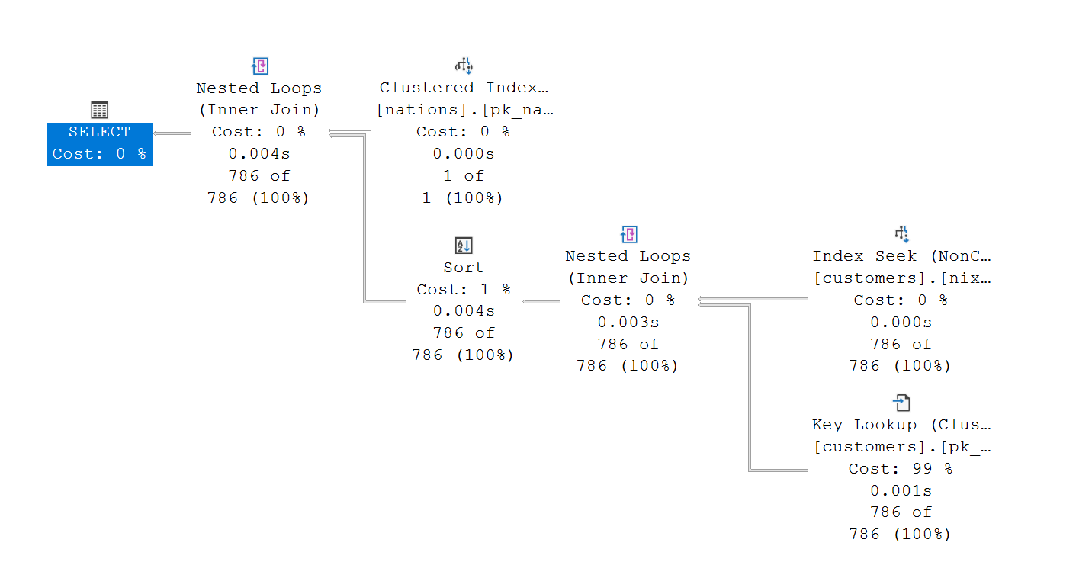

How Parameter Sniffing works
Yes
EXEC dbo.get_customers_by_nation
@n_nationkey = 44;
Does a Plan exist?
Execution
No
Parsing
Compilation
Optimization
Saving the Execution Plan
sniff the value for @n_nationkey
Create the “best” plan for @n_nationkey

Slide 51
Parameter Sniffing

Slide 52
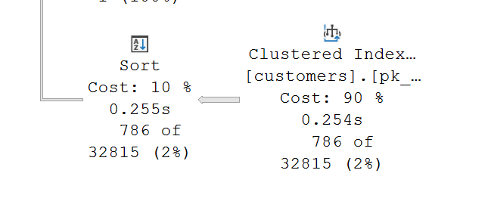
Optimize Parameter Sniffing
OPTIMIZE FOR UNKNOWN
Instead of using the real parameter values (which might be atypical or skewed), SQL Server generates a plan based on statistical averages - as if the parameters were unknown.
Total number of rows
Number of unique values
1.0 / [steps] = density vector
density vector * [rows]

Slide 53
OPTIMIZE FOR (@var = value)
Directs SQL Server to compile the query plan using a specific parameter value, regardless of the actual runtime input.
Forces the optimizer to use statistics and cardinality estimates for the declared value.
Helps stabilize performance by avoiding plans tailored to atypical or skewed values.
Use Case
Queries with predictable performance for certain values.
Workloads affected by data skew or volatile parameter inputs.
Scenarios where plan reuse causes inconsistent execution times.
Benefits
Improves plan stability across executions.
Reduces risk of suboptimal plans due to sniffed values.
Offers fine-grained control over query optimization

Slide 54
Dynamic SQL
Dynamic SQL builds and executes queries as strings at runtime
Avoids reuse of suboptimal plans tied to sniffed parameters.
Benefits:
Improves performance consistency across diverse input values.
Reduces risk of plan reuse issues caused by parameter sniffing.
Offers flexibility to tailor queries dynamically.
Considerations:
Requires careful handling of quoting and SQL injection.
May increase CPU usage due to frequent compilations.
Does not work when FORCED Parameterization is active for the database

Slide 55
https://github.com/db-berater/solving-deadlock-scenarios

